Slide 1
Coal Tar

Slide 2
Index
About Coal Tar
Making Process
Uses of Coal Tar
Coal Tar Pitch
Export Import
Manufacturers and Suppliers
Effects

Slide 3
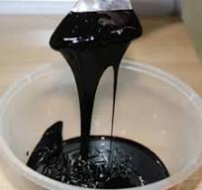
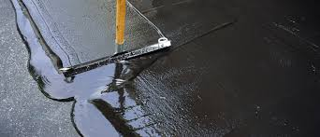
About Coal Tar
Definition: Coal tar is a thick, black, viscous liquid obtained as a byproduct during the production of coke from coal in steel manufacturing.
HS Code 27060010
Composition: It contains a complex mixture of hydrocarbons, including benzene, toluene, naphthalene, and phenols.
Uses: It is used in making dyes, medicines, waterproofing materials, and as a base for road tar and asphalt.
Health & Safety: Coal tar can be toxic and carcinogenic, requiring careful handling in industrial and medicinal applications.
Global Production: Major producers include China, India, the USA, and European countries, with widespread industrial demand.

Slide 4
Specific gravity ranges from 1.12 to 1.20, increasing with carbonization temperature.
Flashpoint: 105–125°C, water solubility <0.2%.
Major Components
Aromatic hydrocarbons (benzene, toluene, xylene, naphthalene, anthracene).
Phenolic compounds (phenol, cresol, xylenol).
Nitrogen compounds (pyridine, quinoline).
Effect of Temperature
Low-temp tar contains more paraffins, olefins, and nitrogen in aniline form.
High-temp tar is richer in benzene, naphthalene, anthracene, and pyridine bases.
Coal Tar Distillates
Carbolic Oil (150–210°C) – Contains phenols and aromatic hydrocarbons.
Naphthalene Oil (210–220°C) – Rich in naphthalene, phenolic compounds.
Creosote Oil (230–290°C) – Contains anthracene, naphthalene, and phenol derivatives.
Anthracene Oil (300–450°C) – Rich in polycyclic hydrocarbons like phenanthrene.
Coal Tar Pitch – A solid residue used in industrial applications.

Slide 5
Making Process of Coal Tar
Blast Furnace Coke
(544 – 635 kg)
1 ton of coal yields
Coke Oven
Coke Breeze
(45 – 90 kg)
Coke Oven Gas
(269 – 325 cubic meters)
Tar (30 – 45 litres)
Ammonium Sulphate
(9 – 12 kg)
Ammonium Liquor
(56 – 132 litres)
Light oil (9.4 – 15 litres)
https://www.slideshare.net/slideshow/production-of-coal-tar-on-industrial-scale/43778842

Slide 6
When coal is heated to make coke (a process called destructive distillation), several byproducts are created. The main byproducts of this process are:
Coke - This is the solid, carbon-rich material that is left after heating coal. It’s used as a fuel and in steel production.
Coal Tar - A dark, thick liquid used in industries like paving and as a source of chemicals.
Ammonia - A gas that is condensed into a liquid and used in fertilizer production.
Methane - A type of gas that can be used as fuel.
Coal Gas - A mixture of gases (including hydrogen, methane, and carbon monoxide) that can be used for heating and lighting.
Sulphur - Often found in coal as sulphur compounds, it can be extracted and turned into sulfuric acid.

Slide 7
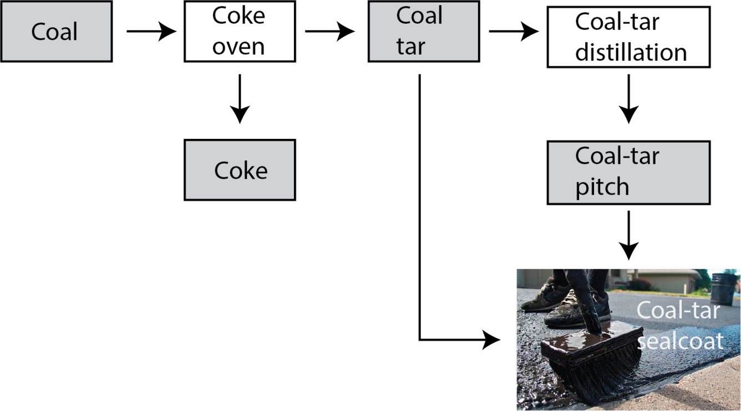
Making Process of Coal Tar
Coking Process: Coal is heated at ~1,000°C in coke ovens without air, releasing gases and vapours.
Collection: Vapours cool and condense into coal tar, with other byproducts like ammonia and benzol.
Distillation: Coal tar is separated into light, middle, heavy oils, and pitch based on boiling points.
Refinement: Extracted chemicals like benzene, toluene, and naphthalene; pitch used in various industries.
https://www.usgs.gov/media/images/flow-diagram-coal-coal-tar-pitch-process

Slide 8
Coal Tar
Distillation < 400-degree Celsius
Naphtha
Naphthalene Oil
Wash Oil
Anthracene Oil
Coal Tar Pitch
Thermal Oxidative Condensation
Reaction Product
Thermal treatment + distillation
Anthracene oil based pitched

Slide 9
Extra Data
Recovery Coke Oven
There are selective Plants that make coal tar.
PSUs
Bhilai Steel Plant (SAIL)
Rourkela Steel Plant (SAIL)
Bokaro Steel Plant (SAIL)
NMDC etc.
Private Companies
Tata Steel BSL
JSPL Angul
JSW Bellary
JSW Dolvi Works
Bhushan Power and Steel limited Works (JSW)
JSL etc.
Price Discovery
Auction
M Junction
Coal Tar Monthly Production
1lakh ton / month
1.2 MnT – Market Size

Slide 10
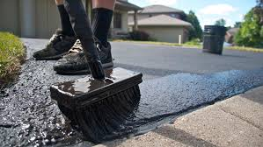
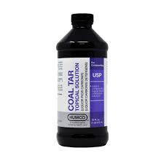
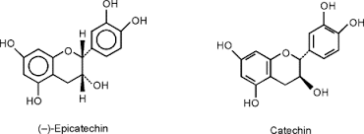
Uses of Coal Tar
Pavement Sealant: Used for asphalt sealing to enhance durability.
Medical Use: Treats skin conditions like psoriasis and eczema.
Dye & Chemical Production: Key ingredient in synthetic dyes and perfumes.
Wood Preservation: Protects wood from decay and insect damage.
Fuel Source: Used in industrial processes due to high carbon content.

Slide 11
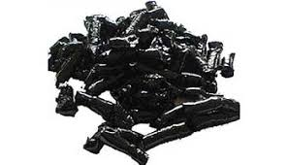
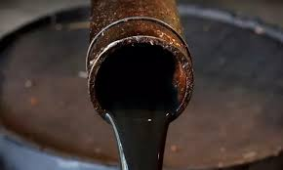
Coal Tar Pitch
Coal tar is converted to coal tar pitch by distillation.
Occurs at 300–400°C (572–752°F).
Volatile components are removed, leaving a viscous residue.
Used in aluminum, graphite, and waterproofing industries.
Pitch has high carbon content and thermal stability.

Slide 12
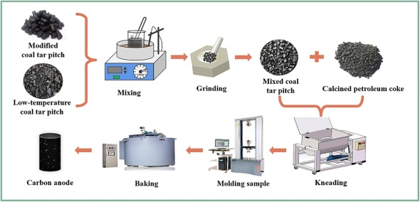
ANODE PRODUCTION
Anode Production: Coal tar pitch is combined with petroleum coke to form anodes for aluminum smelting.
Electrolysis: Anodes conduct electricity, aiding in the breakdown of alumina (Al₂O₃) into aluminum.
High-Temperature Stability: Coal tar pitch withstands extreme temperatures, ensuring durable anodes.
Efficiency: Strong anodes improve the smelting process and aluminum yield.

Slide 13
Indian manufactures and suppliers of coal tar and its derivatives:
Himadri Speciality Chemical Ltd.: Based in Kolkata, Himadri is India's largest coal tar pitch manufacturer, holding over 70% market share.
Choudhary Tar & Chemicals: Established in 1945 in Durgapur, West Bengal, this company produces coal tar pitch, carbon black oil, and other coal tar products
Shree Shyam Chemicals: Founded in 2010 in Bhilai, Chhattisgarh, they manufacture coal tar pitch, light creosote oil, anthracene oil, and crude naphthalene
Konark Tar Products Private Limited: Established in 1993 in Durgapur, West Bengal, they supply coal tar pitch and related products.
Vanajaa Enterprises: Located in Coimbatore, Tamil Nadu, they manufacture coal tar pitch and other related products.
Tata Steel's Industrial By-Product Management Division (IBMD): As a leading coal tar supplier, Tata Steel offers superior quality coal tar with optimal Quinoline Insolubles (QI) and minimal moisture content

Slide 14
Durgapur, West Bengal: Choudhary Tar & Chemicals operates here, manufacturing various coal tar products.
Bhilai, Chhattisgarh: Bhilai Cement is recognized as a significant producer of coal tar and its derivatives.
Visakhapatnam, Andhra Pradesh: Rain Industries Limited has a presence in this region, contributing to coal tar production.

Slide 15
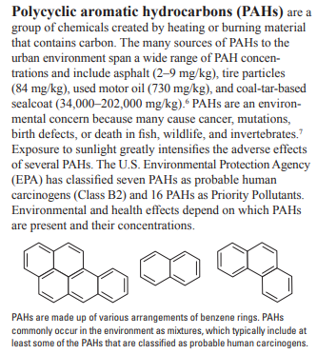
Effects
https://pubs.usgs.gov/fs/2016/3017/fs20163017.pdf

Slide 16
Steel Companies having recovery coke oven plants
Crude Coal Tar
Auction
Coal Tar derivative companies
Make many derivatives of coal tar, one of it is liquid coal tar pitch
Liquid coal tar pitch
Carbon electrode for aluminium smelting

